Slide 1

01

Slide 2
Presentation Overview
02
SQL Questions
10 analytical questions and answers
Data Cleaning
Data cleaning useing Python
Data Modle
Create Star schema
PivotTable
Conditional Formatting
Dashboard
Create Dashoard useing power bi
University Project

Slide 3

13. Original Database Tables
13
semesters
rooms
scholarships
departments
faculty
students
courses
course_prerequisites
sections
enrollments
student_scholarships
research_projects
publications
project_members
grade_events
audit_log
University Project

Slide 4
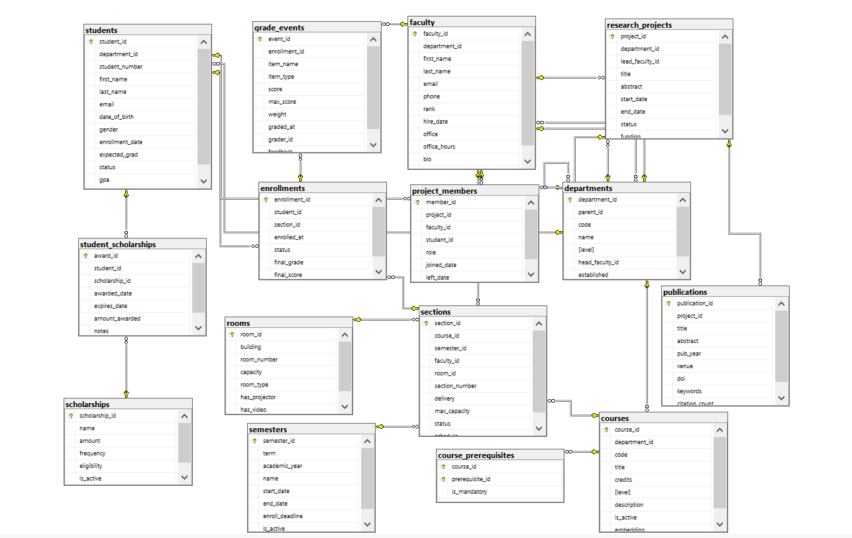
Data Schema (1)
14
University Project

Slide 5
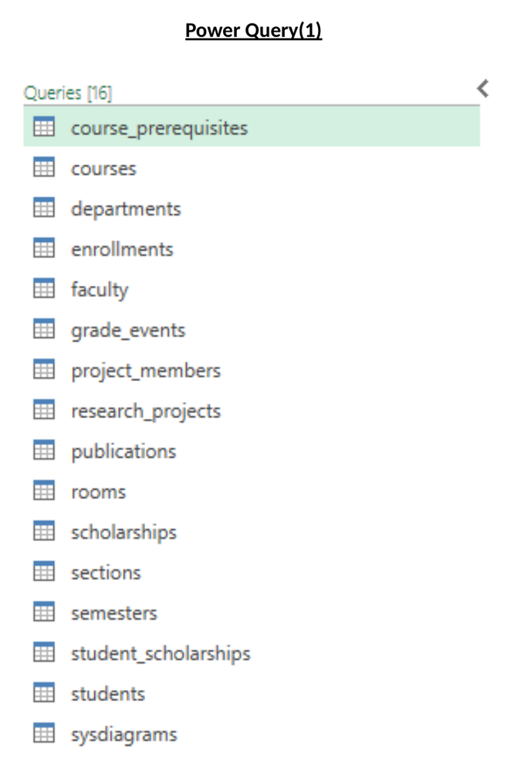
Power Query (1)
15
University Project

Slide 6
1. Student Number
03
SELECT COUNT(*) AS student_number
FROM dbo.students AS S;
ANSWER
Query result shown below.
RESULT: 2,000 students
University Project

Slide 7
2. Student Number in Each Department
04
SELECT D.name AS department_name,
COUNT(S.student_id) AS student_number
FROM dbo.students AS S
JOIN dbo.departments AS D
ON S.department_id = D.department_id
GROUP BY D.name
ORDER BY student_number DESC;
ANSWER
Query result shown below.
RESULT:
Biology 134 | Chemistry 134 | Computer Science 134 | Mathematics 134 | Physics 134 |
Psychology 133 | Sociology 133 | Medicine 133 | Nursing 133 | Philosophy 133 |
Economics 133 | English & Literature 133 | Finance 133 | History 133 | Marketing 133
University Project

Slide 8
3. Average GPA for Students
05
SELECT AVG(S.gpa) AS average_gpa
FROM dbo.students AS S;
ANSWER
Query result shown below.
RESULT: Average GPA = 2.514840
University Project

Slide 9
4. Student Number by Status
06
SELECT S.status,
COUNT(*) AS student_number
FROM dbo.students AS S
GROUP BY S.status
ORDER BY student_number DESC;
ANSWER
Query result shown below.
RESULT: Active = 2,000 students
University Project

Slide 10
5. Course Number in Each Department
07
SELECT D.name AS department_name,
COUNT(C.course_id) AS course_number
FROM dbo.courses AS C
JOIN dbo.departments AS D
ON C.department_id = D.department_id
GROUP BY D.name
ORDER BY course_number DESC;
ANSWER
Query result shown below.
RESULT:
Biology 14 | Chemistry 14 | Computer Science 14 | Mathematics 14 | Physics 14 |
Psychology 13 | Sociology 13 | Medicine 13 | Nursing 13 | Philosophy 13 |
Economics 13 | English & Literature 13 | Finance 13 | History 13 | Marketing 13
University Project

Slide 11
6. Average Final Score for Each Course
08
SELECT C.title AS course_title,
AVG(E.final_score) AS average_final_score
FROM dbo.enrollments AS E
JOIN dbo.sections AS SE
ON E.section_id = SE.section_id
JOIN dbo.courses AS C
ON SE.course_id = C.course_id
GROUP BY C.title
ORDER BY average_final_score DESC;
ANSWER
Query result shown below.
RESULT:
Course 2 - Programming = 80.002500 |
Course 3 - Statistics = 79.998950 |
Course 1 - Database Systems = 79.998875 |
Course 4 - Research Methods = NULL
University Project

Slide 12
7. Top 10 Scholarships by Student Number
09
SELECT TOP 10 SC.name AS scholarship_name,
COUNT(SS.student_id) AS student_number
FROM dbo.scholarships AS SC
JOIN dbo.student_scholarships AS SS
ON SC.scholarship_id = SS.scholarship_id
GROUP BY SC.name
ORDER BY student_number DESC;
ANSWER
Query result shown below.
RESULT:
International Student Bursary 25 | Graduate Research Fellowship 25 |
First-Generation College Award 25 | Entrepreneurship Seed Award 25 |
Diversity & Inclusion Scholarship 25 | Dean's List Scholarship 25 |
Data Science Innovation Award 25 | Community Leadership Award 25 |
Biomedical Research Grant 25 | Athletic Achievement Grant 25
University Project

Slide 13
8. Student Number by Enrollment Status
10
SELECT E.status,
COUNT(*) AS student_number
FROM dbo.enrollments AS E
GROUP BY E.status
ORDER BY student_number DESC;
ANSWER
Query result shown below.
RESULT: Completed = 6,000 | Enrolled = 2,000
University Project

Slide 14
9. Average Final Score by Department
11
SELECT
S.student_id,
S.first_name,
S.last_name,
SUM(SC.amount) AS total_scholarship
FROM dbo.students AS S
JOIN dbo.student_scholarships AS SS
ON S.student_id = SS.student_id
JOIN dbo.scholarships AS SC
ON SS.scholarship_id = SC.scholarship_id
GROUP BY S.student_id, S.first_name, S.last_name
ORDER BY total_scholarship DESC;
ANSWER
Query result shown below.
RESULT:
Mathematics = 80.002500 | Physics = 79.998950 |
Computer Science = 79.998875 | Chemistry = NULL
University Project

Slide 15
10. Faculty with the Highest Number of Sections
12
SELECT TOP 10 F.faculty_id, F.first_name, F.last_name,
COUNT(SE.section_id) AS section_number
FROM dbo.faculty AS F
JOIN dbo.sections AS SE
ON F.faculty_id = SE.faculty_id
GROUP BY F.faculty_id, F.first_name, F.last_name
ORDER BY section_number DESC;
ANSWER
Query result shown below.
RESULT:
Omar Faculty011 = 4 | Ahmed Faculty010 = 4 | Lina Faculty009 = 4 |
Adam Faculty008 = 4 | Hana Faculty007 = 4 | Youssef Faculty006 = 4 |
Nour Faculty005 = 4 | Ali Faculty004 = 4 | Sara Faculty003 = 4 | Mona Faculty002 = 4
University Project

Slide 16
Tables Dropped
16
Drop tables that are not needed for the analysis.
audit_log
grade_events
project_members
publications
research_projects
course_prerequisites
6 tables were removed because they were not needed for the analysis.
University Project

Slide 17
Tables Used for Analysis
17
courses
departments
enrollments
faculty
rooms
scholarships
sections
semesters
student_scholarships
students
10 analysis-ready tables remain.
University Project

Slide 18
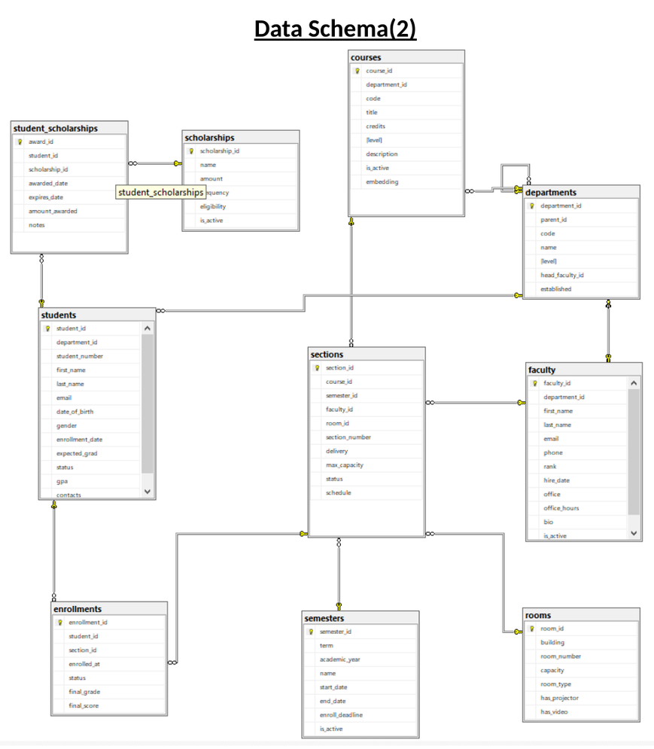
Data Schema (2)
18
University Project

Slide 19
One Big Table — Unified View
20
CREATE VIEW dbo.U_S
AS
SELECT
S.student_id,
S.student_number,
S.first_name AS student_first_name,
S.last_name AS student_last_name,
S.email,
S.department_id,
D.name AS department_name,
F.faculty_id,
F.first_name AS faculty_first_name,
F.last_name AS faculty_last_name,
C.course_id,
C.code AS course_code,
C.title AS course_title,
C.credits,
E.enrollment_id,
E.enrolled_at,
E.status AS enrollment_status,
E.final_grade,
E.final_score
FROM dbo.students AS S;
Unified View / U_S

Slide 20
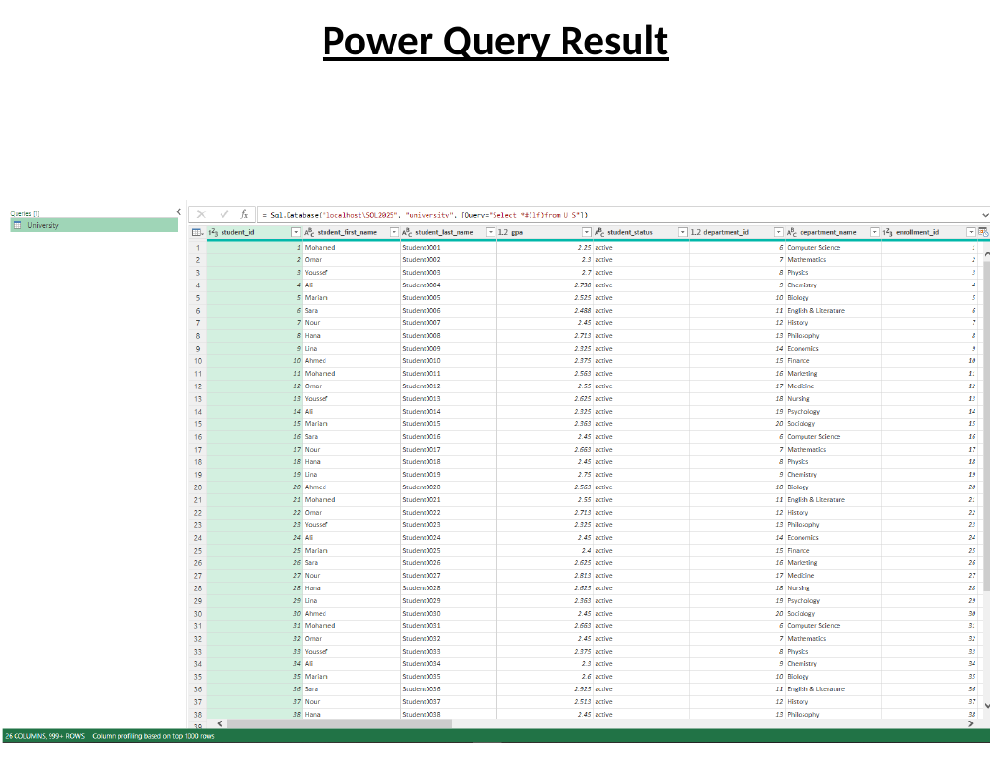
Power Query Result
21
Final Dataset / Power Query Result

Slide 21
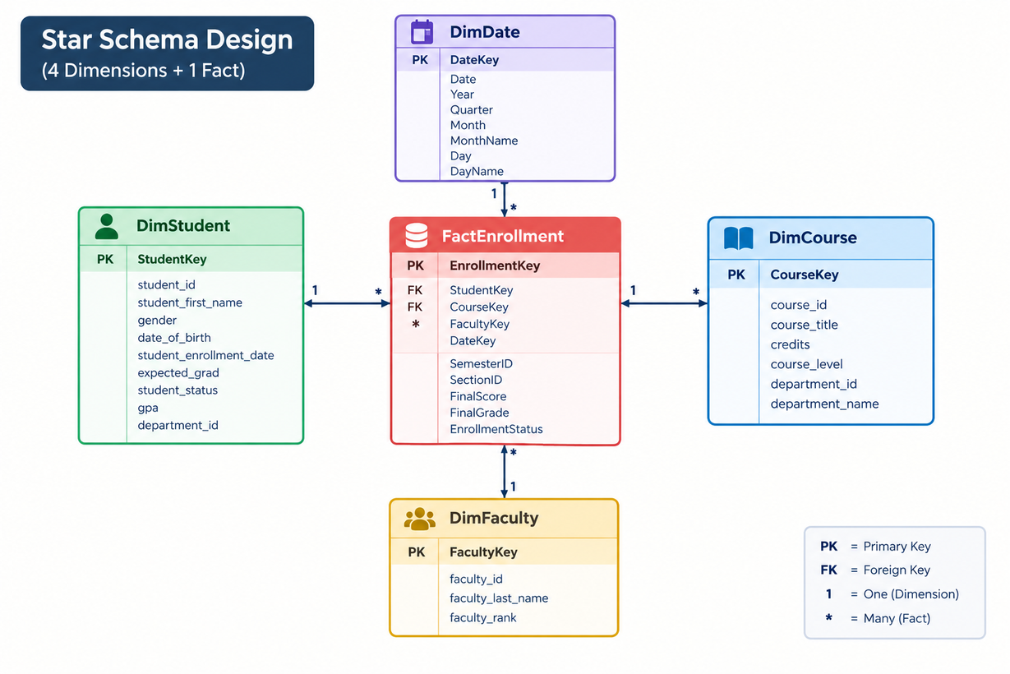
Data Model Useing Power BI
20
Unified View / U_S

Slide 22
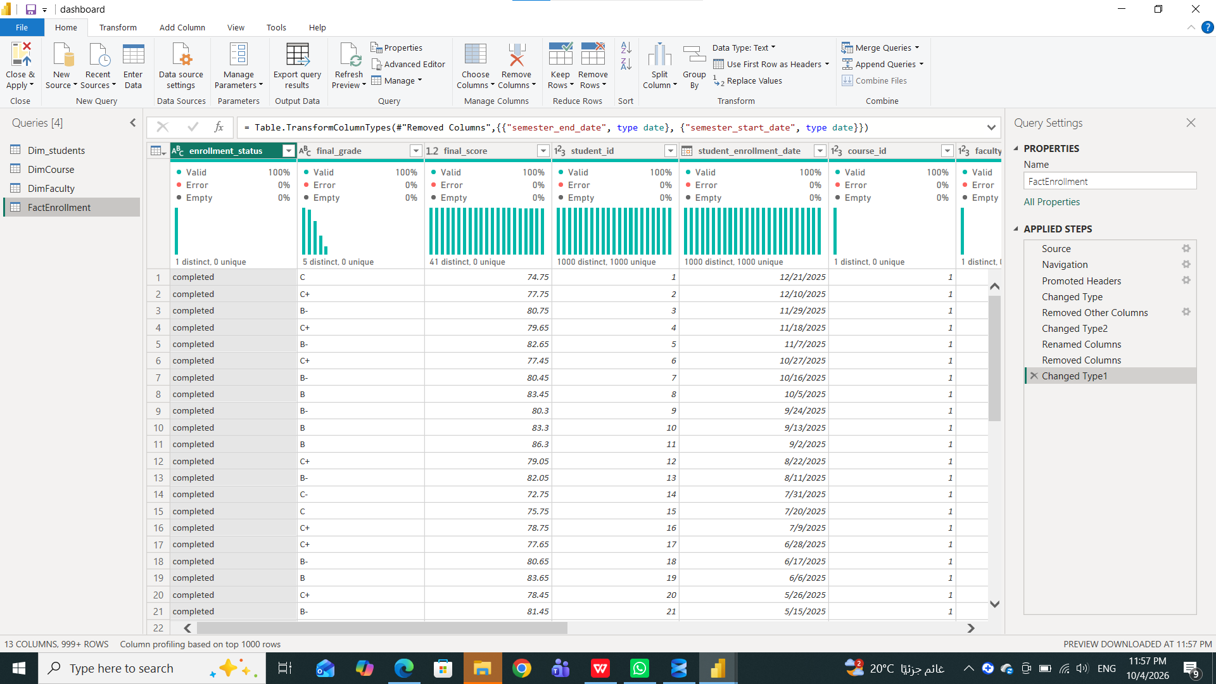
Data Model Useing Power BI
20
Unified View / U_S

Slide 23
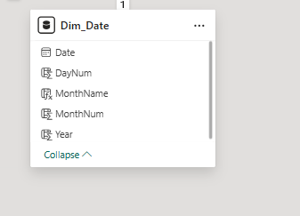
Create Dim_Date
20
Dim_Date = CALENDAR(DATE(2019,1,1), DATE(2025,12,31))
DayNum = Day(Dim_Date[Date].[Date])
MonthName = FORMAT(Dim_Date[Date],"MMM")
MonthNum = MONTH(Dim_Date[Date].[Date])
Year = YEAR(Dim_Date[Date].[Date])
Unified View / U_S

Slide 24
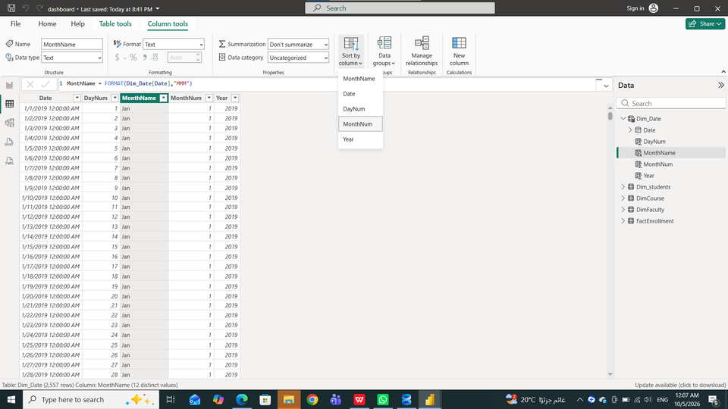
Create Dim_Date
20
Dim_Date = CALENDAR(DATE(2019,1,1), DATE(2025,12,31))
DayNum = Day(Dim_Date[Date].[Date])
MonthName = FORMAT(Dim_Date[Date],"MMM")
MonthNum = MONTH(Dim_Date[Date].[Date])
Year = YEAR(Dim_Date[Date].[Date])
Order Column ⟶ MonthName
sort by column ---> MonthNum
Unified View / U_S

Slide 25
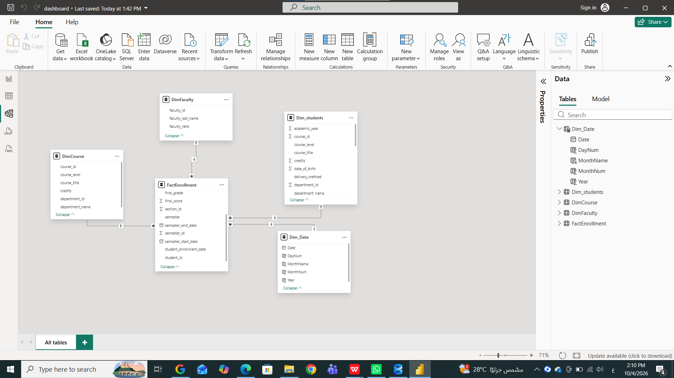
Data Model Useing Power BI
20
Unified View / U_S

Slide 26
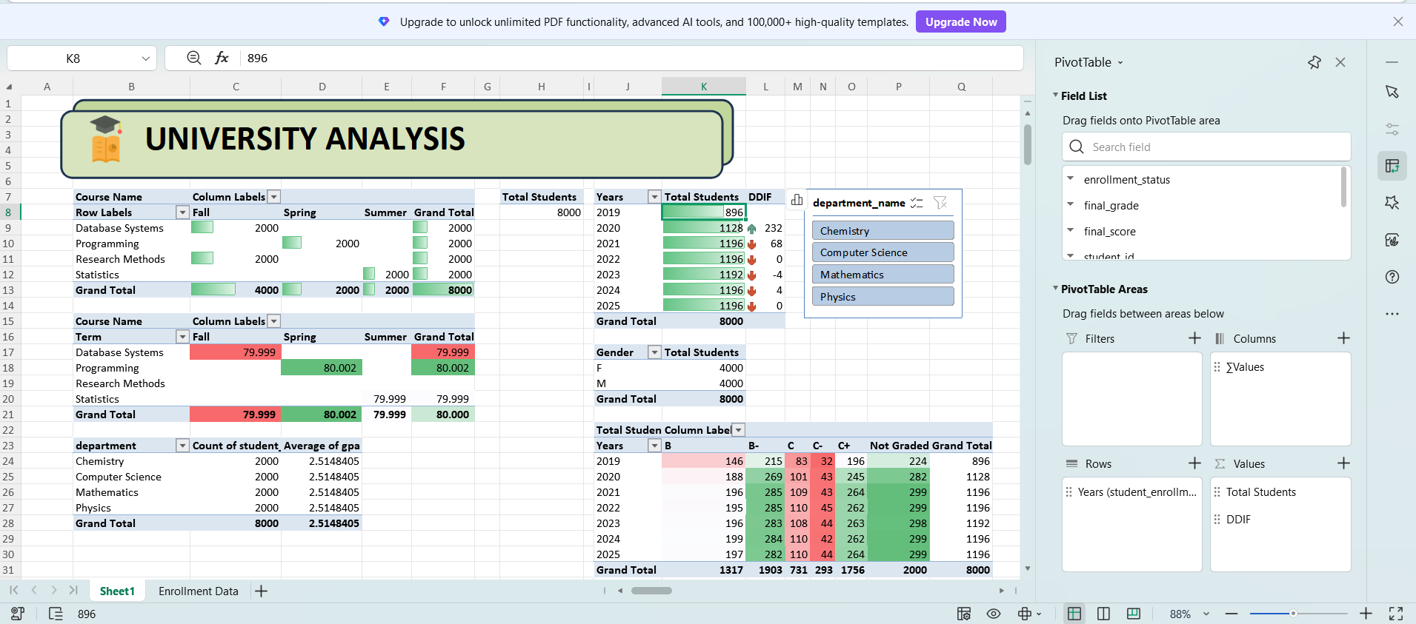
PivotTable
20
Unified View / U_S

Slide 27
Conclusion & Key Insights
27
CONCLUSION
DATA PREPARATION
The analysis transformed the university database into a clean, analysis-ready dataset and a unified view for Power BI. The results show a balanced student distribution, strong course scores around 80, and a 75% completed-enrollment rate.
10 analysis-ready tables
6 unnecessary tables removed
KEY INSIGHTS
PERFORMANCE
• 2,000 students across 15 departments.
Average GPA: 2.51
Completion Rate: 75%
• 200 courses are available across the departments.
• Top course averages are approximately 80 points.
These KPIs summarize the main dimensions of the university dataset before dashboard analysis.
Unified View / U_S

Slide 28


Slide 29

22

